Slide 1

ZEROTH REVIEW AI-Based Personal Finance Advisor: Project Category: RESEARCH
Guide Name Student Name & Registration Number:
Mrs. Vijayalakshmi V Rachit Sood [RA2111028010110]
Papai Mondal [RA2111028010116]
Asmi Shrivastava [RA2111028010119]

Slide 2
Abstract
The creation of an AI-powered personal finance advisor seeks to offer consumers support for management and planning. The system evaluates users' goals, spending patterns, and financial information using machine learning and artificial intelligence technology The software that employs model learning and machine learning along with artificial intelligence analyzes the customers' objectives, their purchasing habits, and the financial information to provide tailored recommendations. AWS Lambda , Amazon S3 , DynamoDB these are just few of the services that this project makes use of. These services give the application's efficiency, security, and scalability. The AI-based personal finance advisor democratizes access to high-quality financial advice by providing users with real-time insights and practical assistance to help them make informed financial decisions.

Slide 3
Introduction
Effectively managing personal money has grown more difficult in the fast-paced world of today. Financial stress and uncertainty are caused by the fact that many people find it difficult to maintain track of their spending, savings, and investments. Although beneficial, traditional financial advising services can be costly and unavailable to a large number of people. The goal of this project is to create a personal finance advisor powered by artificial intelligence and cloud computing that can offer thorough financial advice.
To provide personalized advise, the AI-powered personal finance advisor examines a user's income, spending patterns, long-term objectives, and financial habits. The system makes recommendations for appropriate investment opportunities, suggests budget adjustments, and recognizes spending patterns using sophisticated machine learning algorithms. Through ongoing learning from user input, the adviser is able to adjust to evolving financial situations and provide up-to-date recommendations.

Slide 4
Introduction
Several AWS services are used to guarantee the application's resilience and effectiveness. Serverless computing, made possible by AWS Lambda, enables an application to grow easily and manage several user requests at once. User data is securely and scalably stored via Amazon S3, and dependable and effective database management is guaranteed by Amazon RDS. Furthermore, sensitive financial data is protected by AWS security measures, upholding consumer confidence and adhering to data protection laws.
The goal of this initiative is to make high-quality financial advice accessible to everyone, irrespective of their level of financial knowledge or experience. The AI-based personal finance advisor claims to transform personal finance management and assist customers in achieving financial well-being by utilizing cloud computing and artificial intelligence.

Slide 5
Problem Statement
Traditional financial advisory services are often expensive and inaccessible to many individuals. There is a need for a cost-effective, easily accessible solution that provides personalized financial advice. This project aims to develop an AI-based personal financial advisor that uses advanced algorithms to offer tailored investment recommendations and financial planning services.
“
People struggle with balancing their finances and do not feel safe around money. How might we build an intuitive and trustworthy solution that is also a financial safety net ?
”

Slide 6
Objectives
Integration of AWS AI and ML Services for Decision-Making:
Objective: Utilize AWS SageMaker and AWS Lambda to implement and evaluate AI-driven decision-making processes in personal finance.
Expected Outcome: Enhanced accuracy and efficiency in financial recommendations through the deployment of advanced AI models on AWS.
Real-Time Financial Data Processing Using AWS:
Objective: Leverage AWS services like Amazon Kinesis and AWS Lambda for real-time data ingestion, processing, and analysis of financial transactions.
Expected Outcome: Improved responsiveness and up-to-date financial insights for users, ensuring accurate budget tracking and expense management.

Slide 7
Objectives
Scalability and Performance Analysis with AWS Infrastructure:
Objective: Assess the scalability and performance of the personal finance app using AWS EC2 and AWS Auto Scaling.
Expected Outcome: A robust and scalable architecture capable of handling increased user load without compromising performance.
Enhanced Data Security and Privacy Compliance:
Objective: Implement AWS IAM, AWS KMS, and AWS CloudTrail to secure user data and ensure compliance with privacy regulations.
Expected Outcome: A secure personal finance platform that protects user data and builds trust through stringent security measures and compliance.

Slide 8
Objectives
User Experience Improvement through AWS Integration:
Objective: Use AWS API Gateway and AWS AppSync to create seamless and responsive user interfaces for the personal finance app.
Expected Outcome: A user-friendly and efficient interface that enhances user engagement and satisfaction.
Cost Optimization and Efficiency Analysis:
Objective: Utilize AWS Cost Explorer and AWS Trusted Advisor to optimize the cost-effectiveness of running the personal finance app on AWS.
Expected Outcome: Reduced operational costs while maintaining high service quality, making the app more affordable and accessible.

Slide 9
Objectives
Development of Personalized Financial Education Content:
Objective: Deploy Amazon Personalize and AWS Comprehend to generate and recommend personalized financial education content.
Expected Outcome: Increased user engagement and financial literacy through tailored educational resources.
Evaluation of User Feedback and Engagement:
Objective: Implement AWS CloudWatch and Amazon SNS to monitor user activity and gather feedback in real-time.
Expected Outcome: Continuous improvement of the app based on real-time user feedback and usage patterns.

Slide 10
Objectives
Implementation of Advanced Analytics for Financial Insights:
Objective: Use Amazon Redshift and AWS Glue to perform advanced analytics on user financial data, providing deeper insights and trends.
Expected Outcome: More accurate and insightful financial advice, helping users make better-informed decisions.
Assessment of AI Model Performance and Improvement:
Objective: Leverage AWS SageMaker for training, testing, and refining AI models to improve the accuracy of financial recommendations.
Expected Outcome: Continuous enhancement of AI models leading to more precise and personalized financial advice.

Slide 11
Objectives
Exploration of Market Trends and User Preferences:
Objective: Use AWS QuickSight for visualizing market trends and user preferences based on collected data.
Expected Outcome: Data-driven decisions in app development and feature enhancements, aligning the product with user needs and market demands.
Implementation of Real-Time Notifications and Alerts:
Objective: Utilize Amazon SNS and AWS Lambda to create a system for real-time notifications and alerts for users regarding their financial activities.
Expected Outcome: Proactive user engagement and timely financial advice, enhancing the overall user experience.

Slide 12
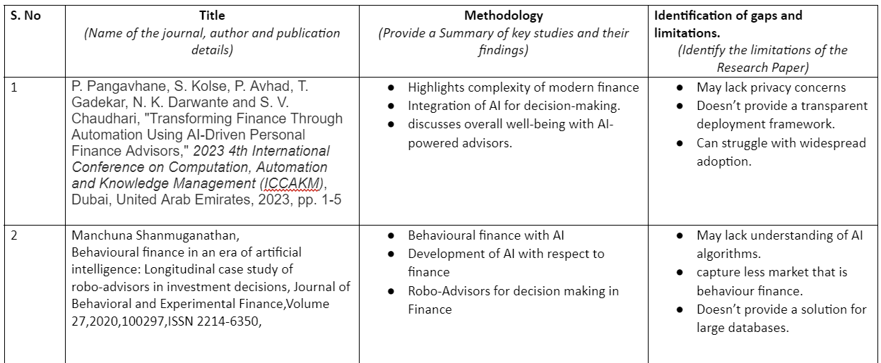
Literature Review

Slide 13
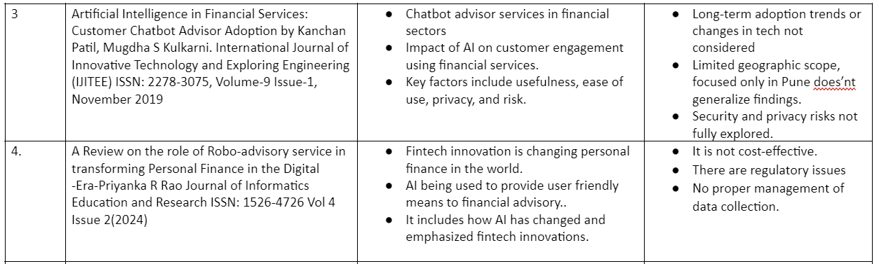
Literature Review

Slide 14
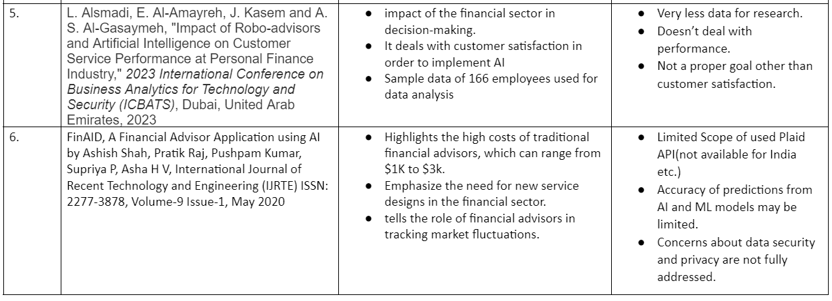
Literature Review

Slide 15
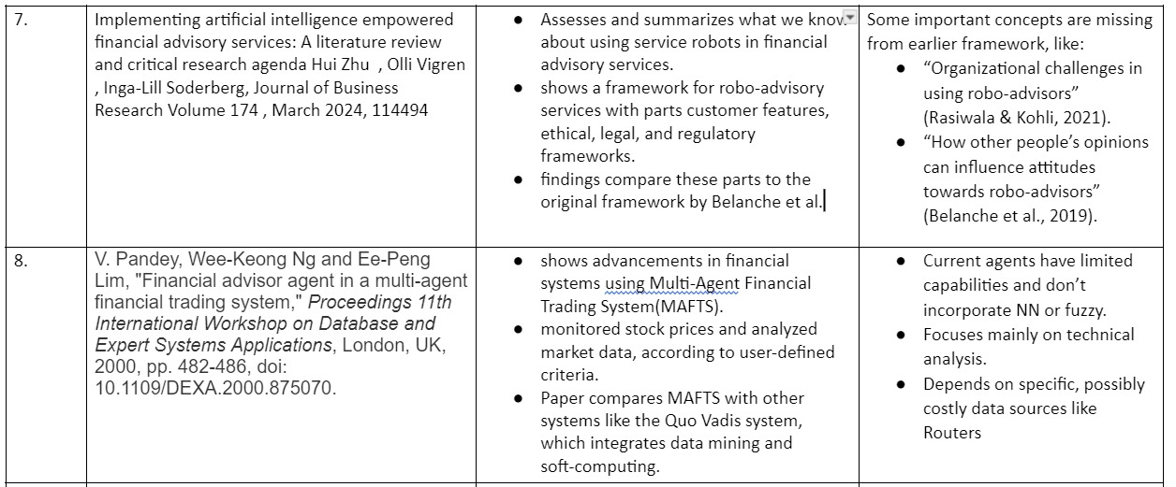
Literature Review

Slide 16
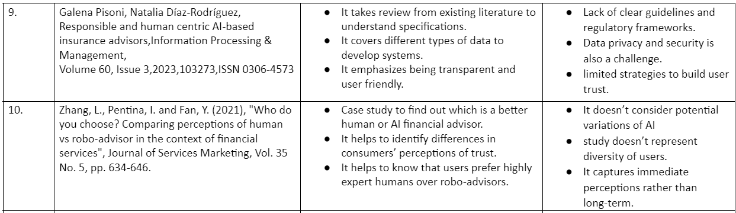
Literature Review

Slide 17
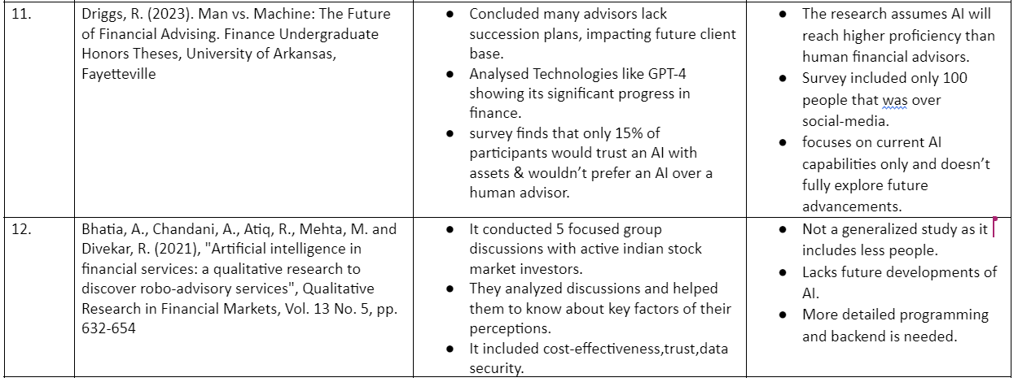
Literature Review

Slide 18
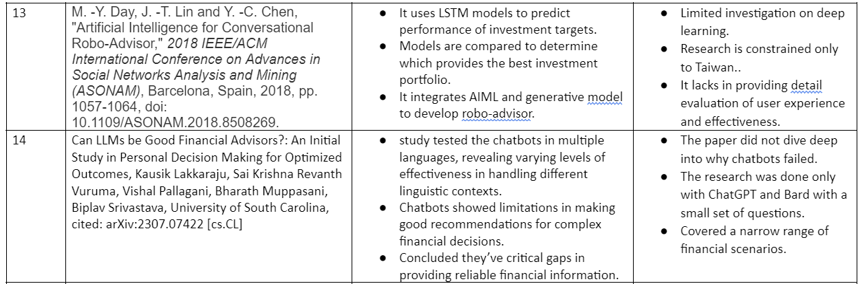
Literature Review

Slide 19
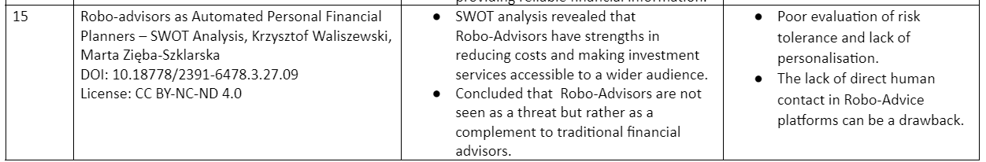
Literature Review

Slide 20
Justification of SDG
The most prominent Sustainable Development Goal (SDG) for our project is
SDG 8: Decent Work and Economic Growth.
Our project promotes financial literacy and empowers individuals to make informed financial decisions, which can lead to improved economic stability and growth. By providing personalized financial advice, the project helps users manage their finances better, potentially increasing savings, investments, and overall financial well-being, thereby contributing to sustained economic growth.
SDG Keywords Mapping:
Economic productivity
Economic growth
Financial services
Poverty eradication

Slide 21
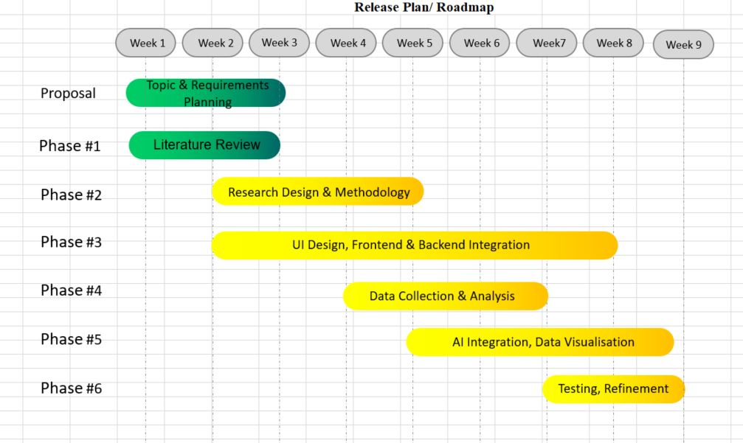
Project Timeline

Slide 22
Conclusion
In summary, AI-powered personal financial advisors are changing the way we manage our finances by making financial advice more accessible and cost-effective. These systems use advanced technology to provide personalized investment strategies and ongoing support. However, challenges remain, including ensuring that these systems are fair and trustworthy. Future research and improvements can help address these issues and make AI-powered financial advisors more effective and trustworthy for users. In the future, the development of AI-powered personal financial advisors has the potential to grow even more.
As technology advances, we can expect these systems to become even more sophisticated, offering greater personalization and more accurate financial forecasting. Additionally, addressing regulatory and ethical concerns will be important to ensure that these tools are both effective and trustworthy. By focusing on these areas, we can improve the value and credibility of AI-powered financial advisors, making them an even more valuable resource for managing personal finances.

